Slide 1
HEART DISEASE
DATA ANALYSIS
Patterns, risk signals and practical priorities from 10,000 patient records
Prepared from the completed Excel analysis
Notes:
[Sources]
- User-provided workbook: Health Data (Heart Disease)complete SKILL.xlsx project 8(3).xlsx
[/Sources]

Slide 2
HEART DISEASE ANALYSIS
One in five patients has recorded heart disease
10,000
2,000
2,216
TOTAL PATIENTS
WITH HEART DISEASE
HIGH-RISK GROUP
Complete records included in the KPI base
20.0% of all patients
22.16% based on the workbook risk score
The most important starting point is the 20% disease prevalence. The high-risk group is slightly larger than the diagnosed group, so screening capacity must cover both confirmed cases and people flagged for follow-up.
02
Notes:
[Sources]
- User-provided workbook: Health Data (Heart Disease)complete SKILL.xlsx project 8(3).xlsx
[/Sources]

Slide 3
HEART DISEASE ANALYSIS
The analysis was cleaned before the comparisons were made
What was corrected
How missing values were handled
• Checked 10,000 patient rows for completeness
Missingness was low—between 0.19% and 0.32% per field. Missing categories were excluded from rate comparisons instead of being treated as a real clinical group. No values were invented, and all percentage calculations used the available records for each variable.
• Standardised Yes/No and category labels
• Grouped cholesterol into desirable, borderline and high
• Created a five-factor risk score and risk categories
Highest missing field: alcohol consumption — 32 records (0.32%)
This approach preserves the original data while preventing ‘N/A’ from appearing as if it were a genuine patient category. Because missingness is below 0.4% in every field, it is unlikely to change the broad comparisons materially.
03
Notes:
[Sources]
- User-provided workbook: Health Data (Heart Disease)complete SKILL.xlsx project 8(3).xlsx
[/Sources]

Slide 4
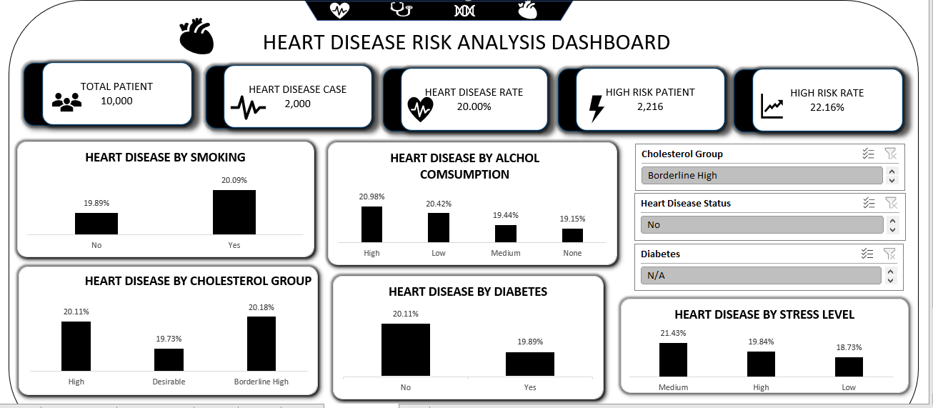
EXECUTIVE DASHBOARD

Slide 5
HEART DISEASE ANALYSIS
Confirmed disease affects 2,000 patients
20%
of the patient population
That is 1 affected patient for every 4 without a recorded diagnosis.
A 20% disease rate is large enough to justify structured screening and follow-up. The 8,000 patients without recorded disease still need prevention messaging, particularly when they carry multiple risk flags.
05
Notes:
[Sources]
- User-provided workbook: Health Data (Heart Disease)complete SKILL.xlsx project 8(3).xlsx
[/Sources]

Slide 6
HEART DISEASE ANALYSIS
The risk score flags more patients than the diagnosis count
High-risk patients account for 22.16%, but their observed disease rate is 20.17%—almost the same as the full dataset. This weak separation means the current score should be validated or recalibrated before it is used for clinical decisions.
06
Notes:
[Sources]
- User-provided workbook: Health Data (Heart Disease)complete SKILL.xlsx project 8(3).xlsx
[/Sources]

Slide 7
HEART DISEASE ANALYSIS
Women show a slightly higher recorded disease rate
Female patients record a 20.69% rate compared with 19.37% for male patients—a 1.32 percentage-point difference. The gap is modest and should guide further investigation, not a conclusion that gender alone explains the outcome.
07
Notes:
[Sources]
- User-provided workbook: Health Data (Heart Disease)complete SKILL.xlsx project 8(3).xlsx
[/Sources]

Slide 8
HEART DISEASE ANALYSIS
Age groups are almost indistinguishable in this dataset
Rates range from 19.52% to 20.43%, with younger groups marginally higher. Because the pattern does not rise with age, this dataset should not be used to infer a normal age–disease relationship without checking how the data was generated or sampled.
08
Notes:
[Sources]
- User-provided workbook: Health Data (Heart Disease)complete SKILL.xlsx project 8(3).xlsx
[/Sources]

Slide 9
HEART DISEASE ANALYSIS
Disease rate rises gradually across the main BMI groups
The rate increases from 18.74% in the healthy-BMI group to 20.80% among patients classified as obese, a 2.06-point difference. This is one of the clearer gradients in the workbook and supports weight-management follow-up, while still avoiding causal claims.
09
Notes:
[Sources]
- User-provided workbook: Health Data (Heart Disease)complete SKILL.xlsx project 8(3).xlsx
[/Sources]

Slide 10
HEART DISEASE ANALYSIS
Medium stress records the highest disease rate
Medium stress reaches 21.43%, compared with 18.73% for low stress. However, the high-stress group does not continue the upward pattern, so stress may be interacting with other variables or the category definitions may need review.
10

Slide 11
HEART DISEASE ANALYSIS
Higher alcohol consumption is associated with a higher rate
Patients reporting high alcohol consumption have a 21.00% disease rate versus 19.26% among non-drinkers. The 1.74-point gap is meaningful for prevention messaging, but adjustment for age, sex, BMI and smoking is needed before attributing the difference to alcohol alone.
11
Notes:
[Sources]
- User-provided workbook: Health Data (Heart Disease)complete SKILL.xlsx project 8(3).xlsx
[/Sources]

Slide 12
HEART DISEASE ANALYSIS
High sugar consumption shows a modest increase
The high-sugar group records 20.60%, around one percentage point above medium consumption. This supports targeted dietary education, although the narrow spread means sugar level is not a strong standalone discriminator in this dataset.
12
Notes:
[Sources]
- User-provided workbook: Health Data (Heart Disease)complete SKILL.xlsx project 8(3).xlsx
[/Sources]

Slide 13
HEART DISEASE ANALYSIS
Cholesterol groups show almost no separation
All three cholesterol groups sit within 0.45 percentage points. Cholesterol remains clinically important, but this workbook’s outcome is too evenly distributed for cholesterol category alone to identify affected patients reliably.
13
Notes:
[Sources]
- User-provided workbook: Health Data (Heart Disease)complete SKILL.xlsx project 8(3).xlsx
[/Sources]

Slide 14
HEART DISEASE ANALYSIS
Exercise levels do not materially separate patient outcomes
The difference between low and medium exercise is only 0.66 percentage points. The result should be treated as a signal that activity categories may be too broad—or that other factors must be considered together—rather than evidence that exercise has little clinical value.
14
Notes:
[Sources]
- User-provided workbook: Health Data (Heart Disease)complete SKILL.xlsx project 8(3).xlsx
[/Sources]

Slide 15
WHAT THE ANALYSIS SHOWS
Seven findings define the story in the data
1. Heart disease is recorded for 20% of patients.
5. High alcohol and high sugar groups sit modestly above baseline.
2. High risk covers 22.16%, but the score barely separates outcomes.
6. Age, exercise and cholesterol groups remain unusually flat.
3. Women have a 1.28-point higher rate than men.
7. Most differences are associative and require statistical validation.
4. BMI shows the clearest gradual increase among major groups.
16
Notes:
[Sources]
- User-provided workbook: Health Data (Heart Disease)complete SKILL.xlsx project 8(3).xlsx
[/Sources]

Slide 16
PRIORITIES FOR ACTION
Act first on screening quality and modifiable risks
01
Validate the risk score
Test sensitivity, specificity and calibration before using the high-risk label for decisions.
02
Prioritise high-risk follow-up
Review the 2,216 flagged patients with confirmed clinical measures and repeat assessment.
03
Strengthen weight support
Offer BMI-based nutrition, activity and referral pathways, especially for obese patients.
04
Target alcohol and sugar
Use brief interventions and practical education for the groups sitting above baseline.
These actions focus on the clearest operational priorities while recognising that the observed differences are small. Screening decisions should combine multiple factors rather than relying on any single category.
17
Notes:
[Sources]
- User-provided workbook: Health Data (Heart Disease)complete SKILL.xlsx project 8(3).xlsx
[/Sources]

Slide 17
NEXT STEPS
Improve the data before making stronger clinical claims
05
Standardise data capture
Replace free-text or missing categories with controlled options and mandatory validation rules.
06
Add clinically relevant context
Include medication, diagnosis date, severity, treatment and follow-up outcomes.
07
Run multivariable modelling
Estimate adjusted effects and confidence intervals instead of relying only on simple percentages.
08
Monitor outcomes over time
Track whether risk scores and interventions predict later diagnoses, admissions or improvement.
Bottom line: use this analysis to prioritise review—not to claim causation.
18
Notes:
[Sources]
- User-provided workbook: Health Data (Heart Disease)complete SKILL.xlsx project 8(3).xlsx
[/Sources]

